Slide 1
Automotive
SPICE
14th March 2023
Ashfin.R

Slide 2

ISO/IEC 15504
ISO/IEC 15504, also termed Software Process Improvement and Capability Determination (SPICE), is a set of technical standards documents for the embedded software development process assessment.
Automotive SPICE is a domain-specific variant of the ISO/IEC 15504 (SPICE).
The purpose of Automotive SPICE is to evaluate the performance of the development processes of ECU suppliers in the automotive industry.
The ASPICE model helps to implement the customer requirements and do the testing in an organized way.

Slide 3
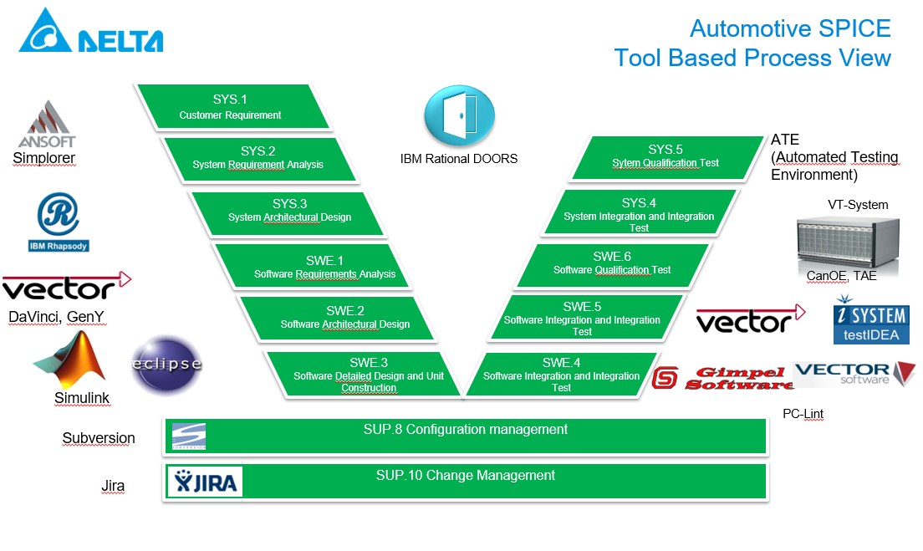
Automotive SPICE

Slide 4
Automotive SPICE
SYS1: Customer Requirements
Includes all the customer requirements
Only for reference
System engineers are supposed to take SYS1 requirement and make it SYS2 requirements
CuRs (Customer Requirements) documents
Path: /00_Customer_Requirements/
SYS2: System Requirement Analysis
SYS2 system engineers need to analyze the requirements from SYS1 and the reviewers either accept or reject them
Defines black-boxes without any internal structure, but defines the external behavior through ports & interfaces.
The SPS (System Performance Specification) Documents
SPSFM (SPS-Fault Management) Document includes the information regarding the DTCs.
Also the CIS (Calibration Interface Description) document
Path: : /10_System/

Slide 5
Automotive SPICE
SYS3: System Architecture Design
Responsibility to understand the SYS2 requirements and design the system architecture.
Need to define all controllers as white boxes with internal structure based on the system requirement.
Defines all system blocks
Eg: DSPA system architecture design
SWE1: Software Requirement Analysis:
Analyze the system requirement and produce the software requirement.
Eg: producing a PWM signal of 1MHz, reading an ADC of address 0x22 at 10sps
Both SYS3 and SWE1 together create the SAD (System Architecture Design) Document
Path: /10_System/

Slide 6
Automotive SPICE
SWE2: Software Architecture Design
To design the software architecture based on the software requirement
Includes the SWC to cover all the SWE1 requirements
The SDD (Software Design Description) Document
Path: /20_Software/
SWE3: Software Detailed Design and Unit Construction
To create the detailed descriptions of all individual SWC function design & implementation
The SCDD (Software Component Detailed Description) Document
Path: /20_Software/SCDD Library/
Once implementation is done, the code is committed to the SVN
Further modifications are done using the JIRA tickets

Slide 7
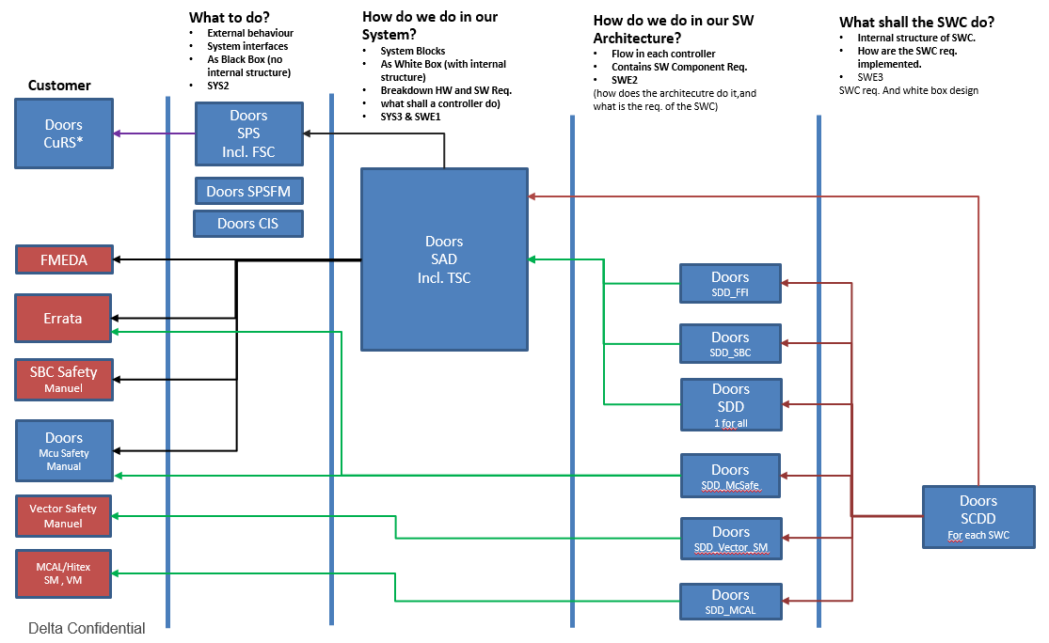
Automotive SPICE: Document correspondence

Slide 8
Reference
Presentation on the A-SPICE Model https://desoeap16.delta.corp/svn/IPB_22kW_auto_pag/trunk/20_Design/23_Software/230_Management/ProjectHandbook/Delta_SYS_SW_ReqEng_at_Delta.pptx

